Slide 1
Authorship analysis
Himanshu Singh
MS-CS Grad Student
Illinois Institute of Technology
Joris Ekpangbo
ITM Grad Student, Specializing in Data Management. Interested in Machine Learning, Data Analytics, and Big Data.

Slide 2
Agenda
Introduction
The Data set
The Unmasking Procedure
Experimental results
Conclusion
Questions
References

Slide 3
Introduction

Slide 4
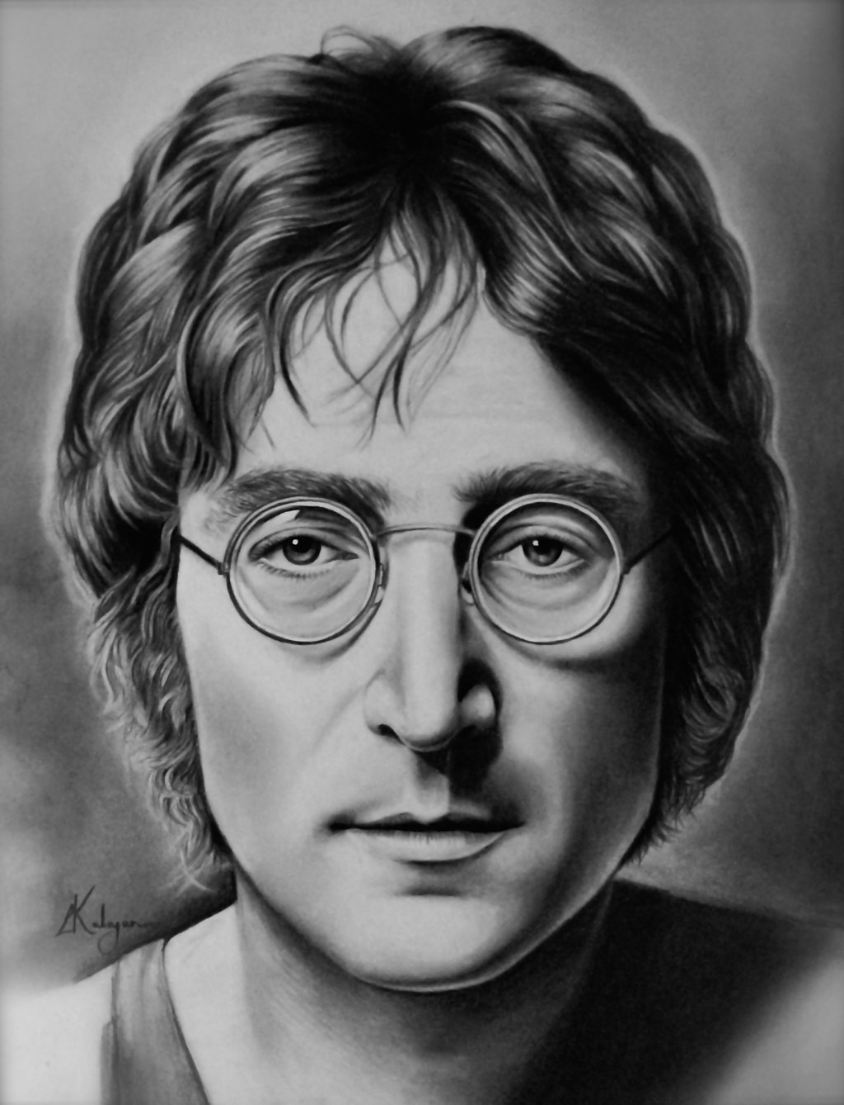
QUIZ 1: WHO WROTE THIS?
“You may say I'm a dreamer, but I'm not the only one. I hope someday you'll join us. And the world will live as one.”

Slide 5
QUIZ 2: WHO WROTE THIS?
“Le travail éloigne de nous trois grands maux:
l’Ennui, le Vice et le Besoin.”
Having a job prevents us from three great illnesses:
Boredom, Vice and Need.
Since we don’t know the author of this quote let’s suppose that our mission would be to find out who wrote it.
Here is our first basic authorship attribution problem!

Slide 6
What is the authorship attribution?
Basically, the Authorship attribution consists of identifying the author of a given text. Given a set of works from an anonymous author, the main concern would be to find this author by looking into internal text evidences. This task can covet three possible forms:
The Author Profiling problem, where we have no idea of what kind of author has written the text to be studied, which means no set of candidates authors (in this scenario, our task would be an unsupervised learning one),
The Needle-in-a-haystack problem, where we have a big set of candidates with a limited writing sample for each and given this training set we have to determine which one has written the text considered in the study and,
The Authorship Verification problem, where we have one alleged author of a text, we have to verify if he/she is the actual writer(Koppel et. al., 2008).

Slide 7
How to Solve such a problem?
How can we solve efficiently and accurately an authorship attribution problem? Over the last century and more, a great variety of analytical methods have been applied to authorship attribution problems (cf. Juola 2008). They can be classified into three main classes of approaches:
the earliest, unitary invariant, approach, in which a single numeric function of a text is determined to discriminate between authors,
the multivariate analysis approach, in which statistical multivariate discriminant analysis is applied to word frequencies and related numerical features and,
the most recent, machine learning approach, in which modern machine learning methods are applied to sets of training documents to construct classifiers to new anonymous documents.

Slide 8
Nowadays, the most successful methods used to address an Authorship Attribution have been found to be the modern machine learning algorithms, since these models present not only a high accuracy rate but also a diversity of works published helping to understand and implement them.
To address our Authorship Verification problem, I implemented machine learning methods to perform an Unmasking Procedure, proven to be a robust way to solve this problem. (Koppel et. al., 2007).

Slide 9
The objective of this project was to update an existing Python library (using scikit-learn) to determine (thanks to the Unmasking Procedure) whether a document is written by a given author or not (i.e address an Authorship Verification problem). The final goal being to determine if some editorials allegedly written by the famous American Poet Walter "Walt" Whitman (signed anonymously with pseudonyms and dated from 1857) are really products of his clever pen.
This project could help build a new set of all the documents written by this wonderful Poet.

Slide 10

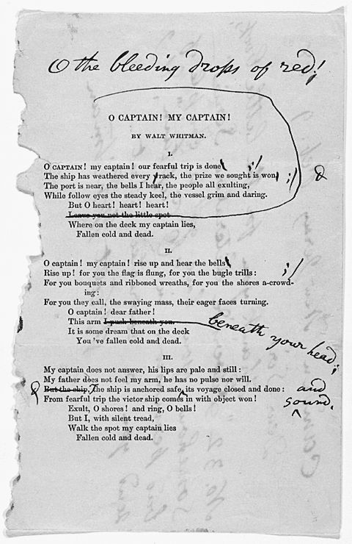
I. The Data set

Slide 11
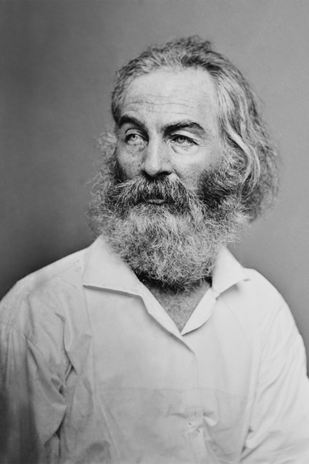
Who is Walter “walt” Whitman?
Walter "Walt" Whitman (May 31, 1819 – March 26, 1892) Born in Huntington on Long Island, was an American poet, essayist, journalist, teacher, government clerk and accessorily during the American Civil War a volunteer nurse.
Whitman is among the most influential poets in the American canon, often called the father of free verse. His work was very controversial in its time, particularly his poetry collection Leaves of Grass, which was described as obscene for its overt sexuality.

Slide 12
This collection was first published in 1855 with his own money. He continued expanding and revising it until his death in 1892.
(Source https://en.wikipedia.org/wiki/Walt_Whitman)
He allegedly has written numerous editorials for the New York Herald, the Brooklyn Daily Eagle, and the New York Daily Tribune in 1857, that he signed with pseudonyms. For our procedure, we used a set of texts (a total of 631 articles) known to have been written by Whitman, and the other set containing the anonymous texts allegedly written by him (a total of 313, separated by month of publication).
Notes:
After a stroke towards the end of his life, he moved to Camden, New Jersey, where his health further declined. When he died at age 72, his funeral became a public spectacle.

Slide 13
KNOWN editorials written by Whitman
https://drive.google.com/drive/folders/0B065CFlVfv6lY2twbF9PX09vcGs

Slide 14
Some unknown editorials…
From the New York Herald (in 1857)
https://drive.google.com/drive/folders/0B065CFlVfv6lbDUtTWlIY3lfWVU
From the Brooklyn Daily Eagle (in 1857)
https://drive.google.com/drive/folders/0B065CFlVfv6lRGpTLTdWaDRiWTg
From the New York Daily Tribune (in 1857)
https://drive.google.com/drive/folders/0B065CFlVfv6lMzhidnphRzdHbTg
Notes:
Some reading (DownloadDocument-10)

Slide 15
Using the NLTK (Natural Language Toolkit) framework of Python, the texts were divided by size into chunks, using 250 words per chunk, in accordance with the logic of their paragraphs (no paragraph shared between two chunks). For the labeled set (training set), 854 chunks were formed, and for the unlabeled set, we got 580 chunks.

Slide 16
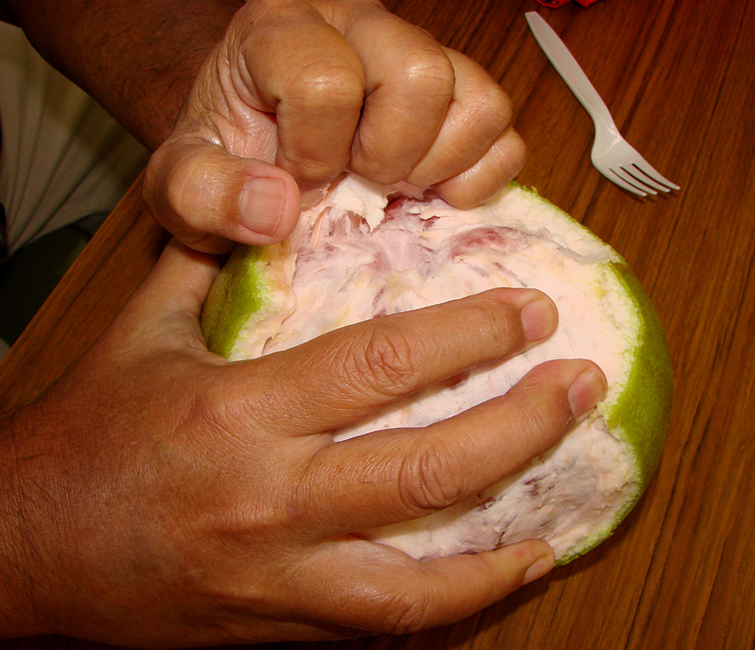

II. The unmasking procedure
Notice: At some point of its process, this procedure is somehow similar to pealing a fruit iteratively until we find what characterizes it the most: its core.

Slide 17
Why is the Authorship verification more difficult than the attribution?
Let’s suppose that we want to determine if a text was written by Shakespeare or Poe. It would be sufficient to use their respective known writings, to construct a model distinguishing them, and to test the unknown text against the model (Koppel 2007).
On the other hand, if we need to determine if a text was written by Shakespeare or not, in the same fashion, we would have to build a model distinguishing Shakespeare and not-Shakespeare which it is very difficult, if not impossible to do. Simply because, it’s hardly possible to assemble an exhaustive, or even representative, sample of not-Shakespeare. First of all, because a single author may consciously vary his or her style from text to text for many reasons or may unconsciously drift stylistically over time.
Notes:
When the anonymous author of a text is to be found amongst a list of possible authors, the goal is usually to find which one is more likely to have written it. The probability of each author to have written the targeted text is assessed. The target author would be the “most probable one”.
On the other hand, when we have to determine whether a given text is written by a targeted author or not, it becomes a harder problem. In this case, first we will have to do a comparison between the works of this author and every other work not written by him/her. Then, determine in which of these two cases the given text is more probable to fit.

Slide 18
Thus researchers must learn to somehow distinguish between relatively shallow differences that reflect conscious or unconscious changes in an author’s style and deeper differences that reflect styles of different authors.
Consequently, the fact that a particular text is more similar to the known works of Shakespeare than to those of some given set of other authors (non Shakespearian authors) does not irrefutably mean that its was written by Shakespeare. It might rather have been written by some other author not considered at all.
Basically the Authorship Verification is a real nightmare!

Slide 19
What if instead?
What if instead of building a model distinguishing author A from author not-A or author known from unknown author, given two example sets, we build two models for each set. Then, we create a method to determine whether these models were generated by the same process (same author) or by two different processes (different authors).
This new method would assess the depth of difference between the two example sets, the underlying idea being to test the rate of degradation of the accuracy of learned models as the best features are iteratively dropped from the learning process (Koppel et. al., 2007). This method is the Unmasking Procedure.

Slide 20

III. Experimental results

Slide 21
First, a classifier is trained with the works signed by Whitman and the data set containing his allegedly writings, signed by a pseudonym.
Second, using the 350 most frequent words as features initially, we compare the two models and assess this comparison to get an accuracy of how well a machine learning algorithm could classify them (the same or different).
Afterwards, the top 10 most informative features, that more easily distinguish both sets, are removed and the same process is repeated.
A simple pattern of the gradual decrement of the accuracy should point out the writings being made by Whitman or not.

Slide 22
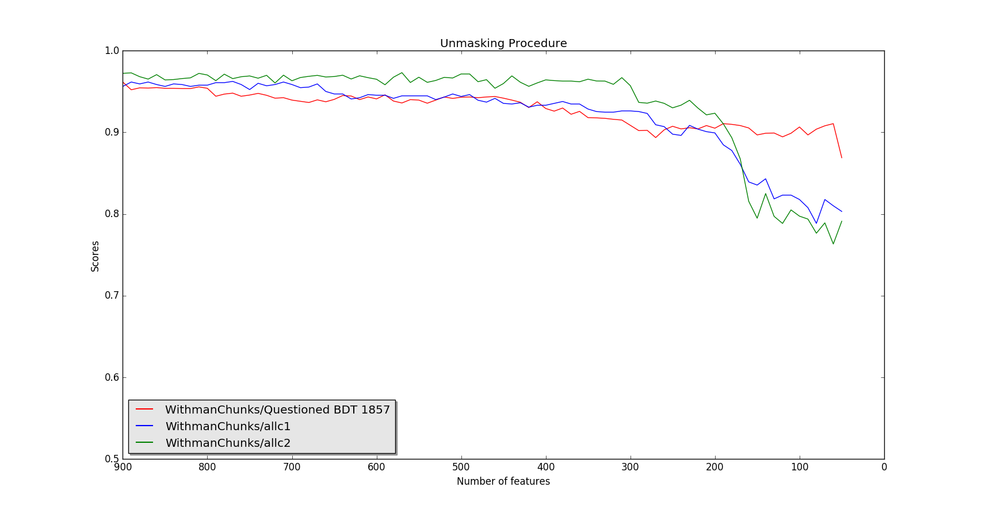

Slide 23
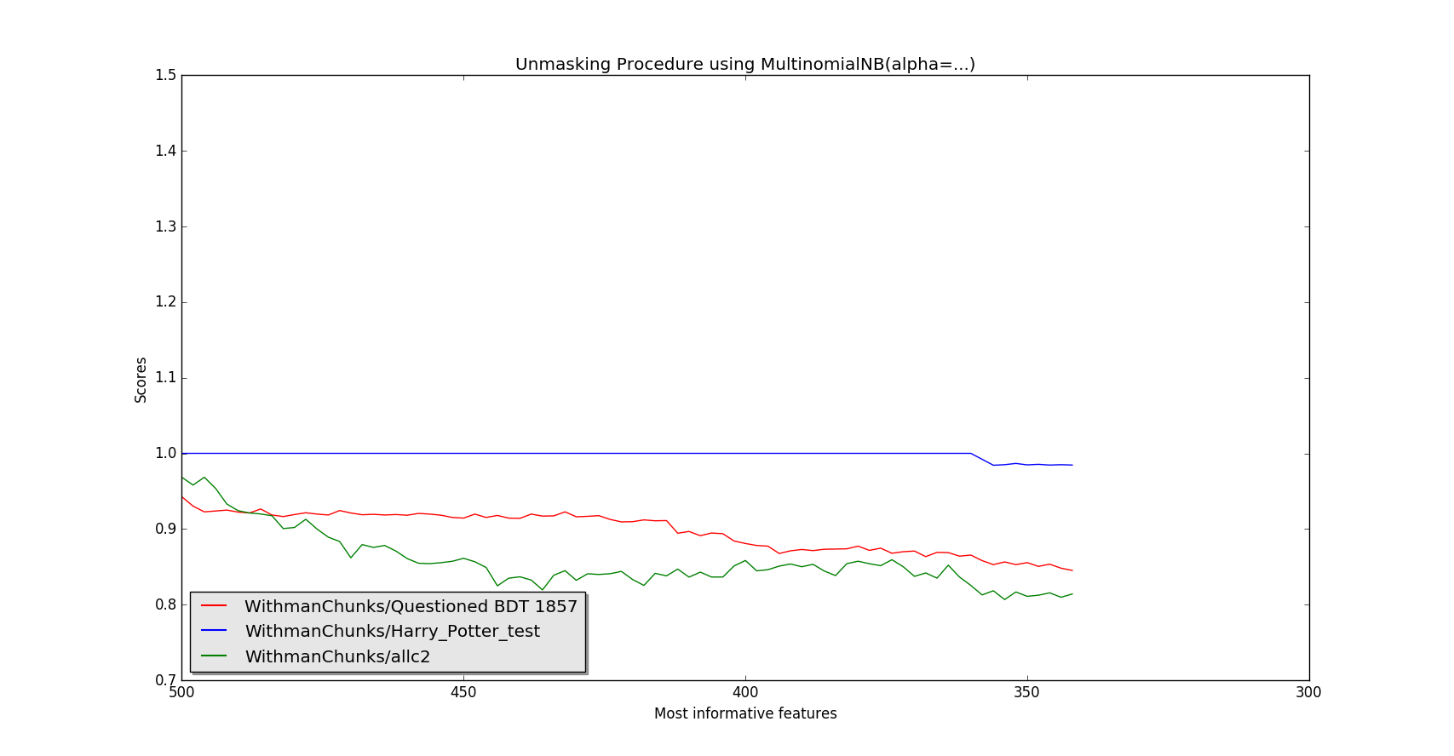

Slide 24
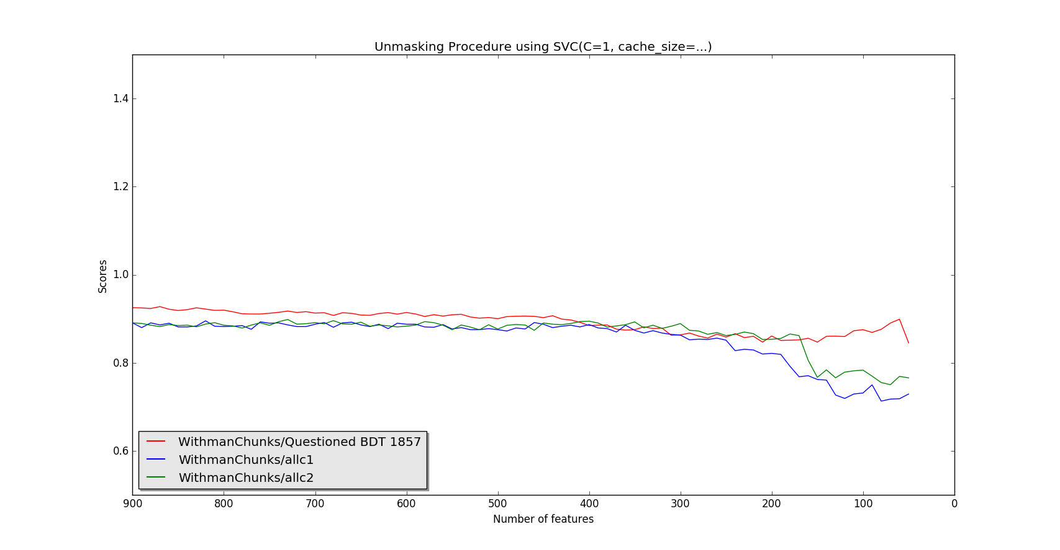

Slide 25
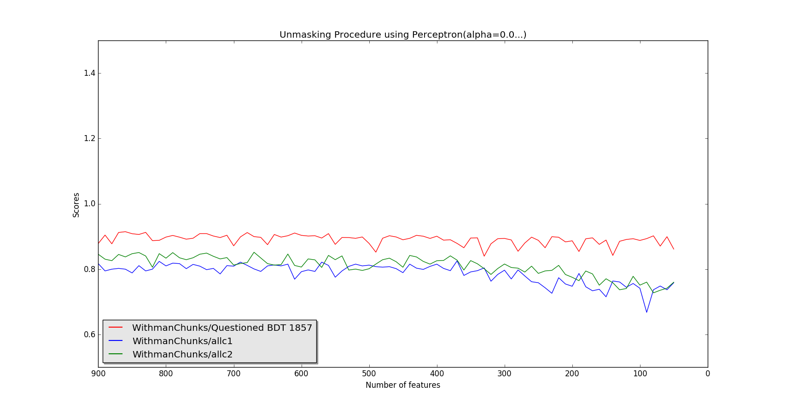

Slide 26
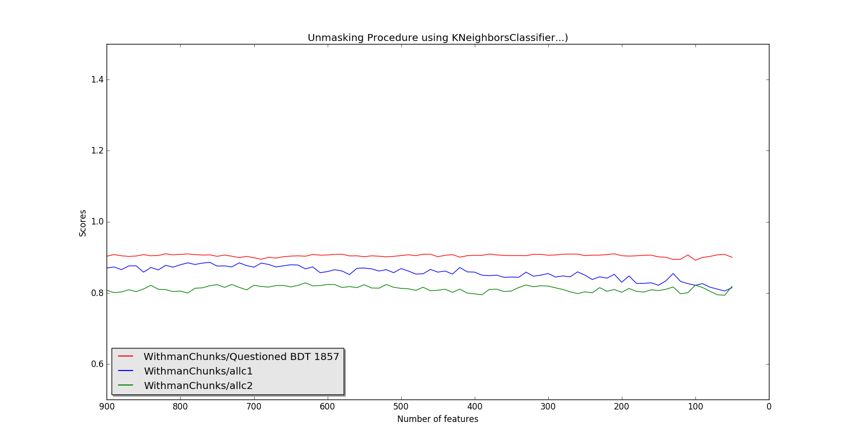

Slide 27
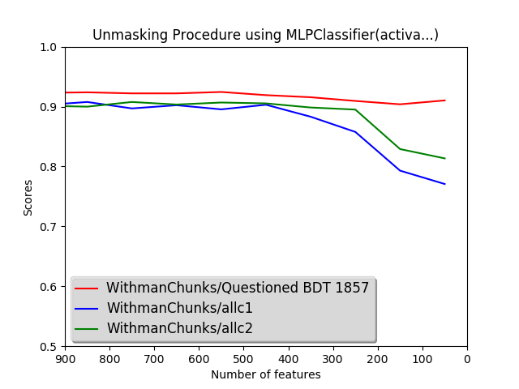

Slide 28
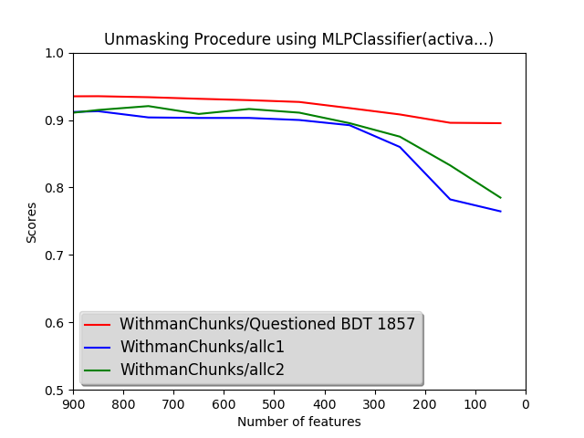

Slide 29
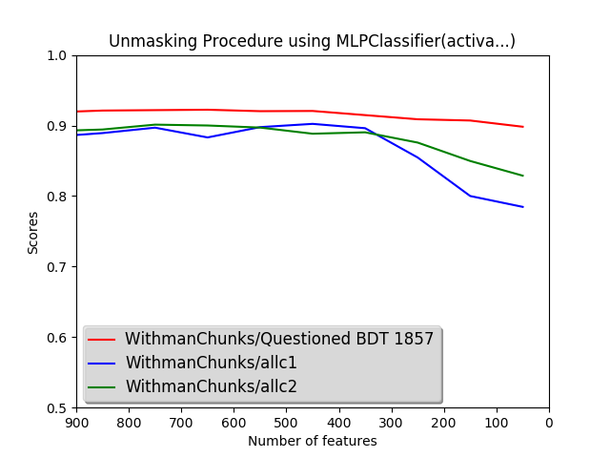

Slide 30

Conclusion

Slide 31
What is the Authorship Attribution?
It’s the task consisting of finding the potential author of an anonymous writing.
What kind of Authorship Attribution problems do we have?
The Profiling issue, when we are in the total dark (no previous knowledge about the author). The least we can do is profile him/her;
The Needle-in-a-haystack issue, when we have to choose the most likely author in a given set of candidates;
The Authorship Verification, when we have to determine whether the text was written by a given author or not.
How do we address those problems?
The unitary invariant approach (which has been proven to be obsolete): each writing of any author is marked by a unique invariant characterizing the relationship between the frequent words he/she uses and their length;
The multivariate analysis approach: the style of an author can be characterized based on multiple textual clues;
The machine learning approach: using machine learning methods, we classify unknown documents

Slide 32
Why is the Authorship Verification difficult to perform?
Its difficulty to be perform lays in the fact that it’s quasi impossible to assemble an exhaustive non-Author-to-be-verified writings set in the first place for the next steps of this process to be perform. But the Unmasking procedure has been proven to be a robust method to perform it.
What is the Unmasking Procedure?
Consists of building two models from two training sets generated based on the know work of our given author to be verified and the anonymous set considered for the analysis. Then a machine learning method would compare those two models and would be assessed how well this method classify them (same or different authors). Its gradual decrement of accuracy would show if the writing is the work of our author or not.
Does the Python library implemented throughout this project work?
The library implemented generates results in accordance with the previous work done.

Slide 33
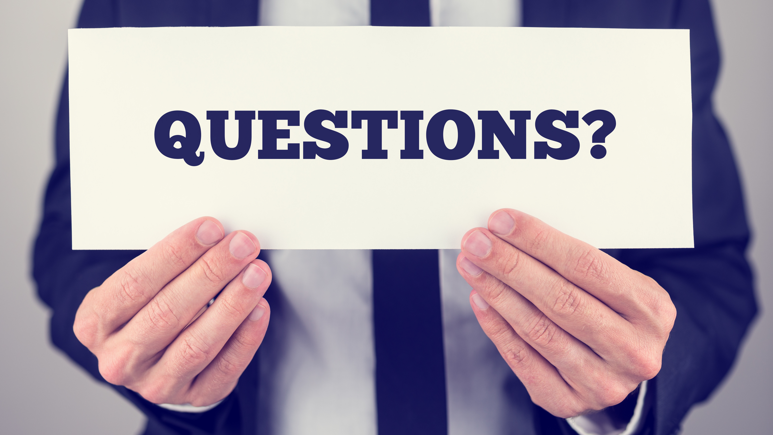

Slide 34

REFERENCES

Slide 35
Rosa María C., Luis V., Manuel M. & Paolo R., Authorship Attribution using Word Sequences, Retrieved from http://users.dsic.upv.es/~prosso/resources/CoyotlEtAl_CIARP06.pdf on 11/22/2016
Moshe K., Jonathan S. & Shlomo A., Computational Methods in Authorship Attribution, Dept. of Computer Science, Bar-Ilan University (Ramat-Gan, Israel) and Dept. of Computer Science, Illinois Institute of Technology (Chicago, USA)
Moshe K., Jonathan S. Elisheva B., Measuring Differentiability: Unmasking Pseudonymous Authors, Dept. of Computer Science, Bar-Ilan University (Ramat-Gan, Israel)
Walt Whitman (Article), Retrieved from https://en.wikipedia.org/wiki/Walt_Whitman on11/22/2016

